Slide 1
Project (P141) : Telecom Churn
Presented by: Group 4

Slide 2
Project (P141) : Telecom Churn
Presented by: Group 4

Slide 3
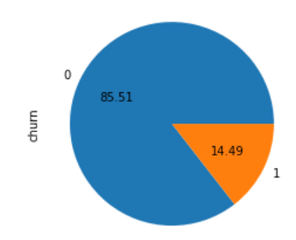
Business Objective: To build a classification model in order to predict Telecom churn probability, conditioned on the given customer features.
Exploratory Data Analysis
Customer churn is a big problem for telecommunications companies. After analyzing the given data, churn for the given Telecom company is 14.5%.
1 = Churned customer
0 = Loyal customer

Slide 4
1) 75% of the customers made 2 customer service calls.However, the maximum customer service calls made were 9. 2) 25% of the customers remained with Telecom provider for the account length of 74, less than the average of 101. 3) 50% of the customers did not make use of voice mail messages. 4) 25% of the customers talked less than the average during day, evening and night time. 5) 25% of the customers spent less time than the mean on international calls
Business pain points

Slide 5
Churned customer Analysis 1) 25% of the customers who churned were with the Telecom provider for account length of 76 against mean of 101(as stated in previous slide). 2) 75% of the churned customers did not make use of voice mail messages at all. 3) Churned customers talk time in minutes is higher than the average customer during day ,evening and night time, resulting in considerable revenue loss. 4) Also, for the international calls, churned customers talk time in minutes is higher than the average customer. 5) Revenue generated by the churned customers on an average is higher than that of overall customers. 6) 75% of the churned customers made 4 customer service calls with the maximum calls made were 9.
Classwise Churn Analysis

Slide 6
Loyal customer Analysis 1) On an average, the revenue generated by the retained customers is less than that generated by churned customers. 2) Retained customers spend less time talking on phone during day,evening & night time when compared to churned customers. 3) Retained customers also spend less time talking internationally against customers who left the Telecom provider. .
Classwise Churn Analysis

Slide 7
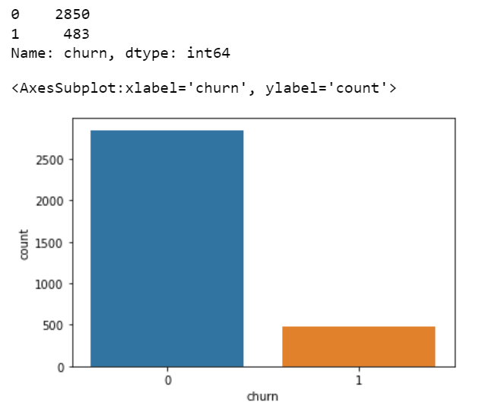
The target variable is “churn” in the given dataset. The barchart below clearly shows class imbalance which may affect the model prediction and needs to be taken care of while model building.
Target variable
1 = Churned customer
0 = Loyal customer

Slide 8
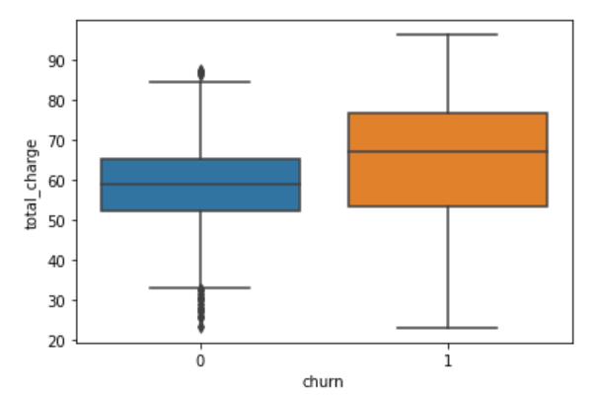
From the boxplot, we can see that customers who left the Telecom provider contributed more towards the revenue
Feature Analysis

Slide 9
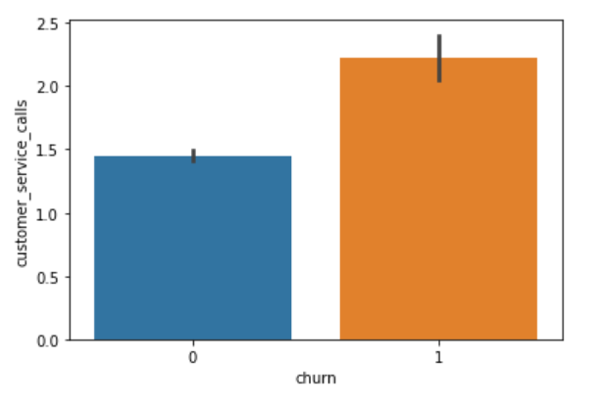
The churned customers on an average made more customer service calls than those who did not churn
Feature Analysis

Slide 10
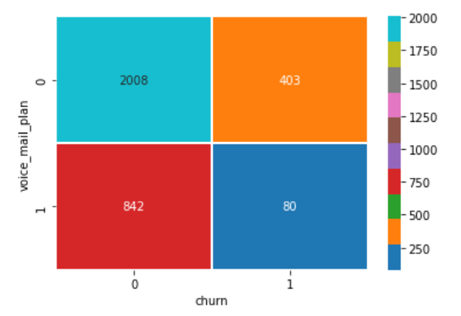
The heatmap clearly shows that 403 customers who churned had adopted '0' voice mail plan.
Feature Analysis

Slide 11
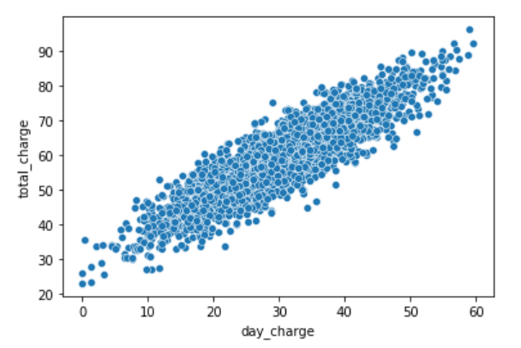
We can see that day charge is positively correlated to total charge
Feature Analysis

Slide 12
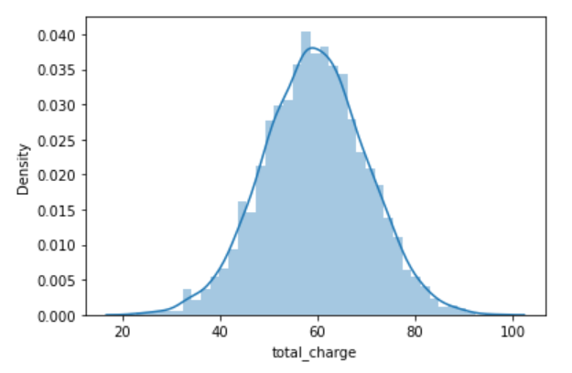
The probability density of total charge being 59 is the highest.
Feature Analysis

Slide 13
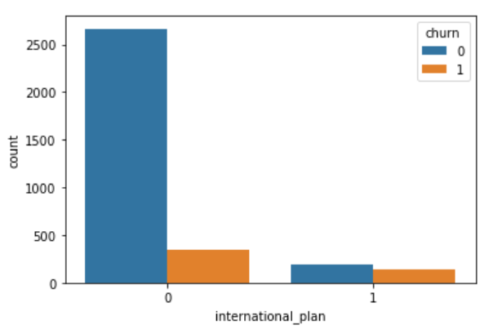
Customers who had adopted ‘0’ international plan churned more in number than who had adopted ‘1’ international plan.
Feature Analysis

Slide 14
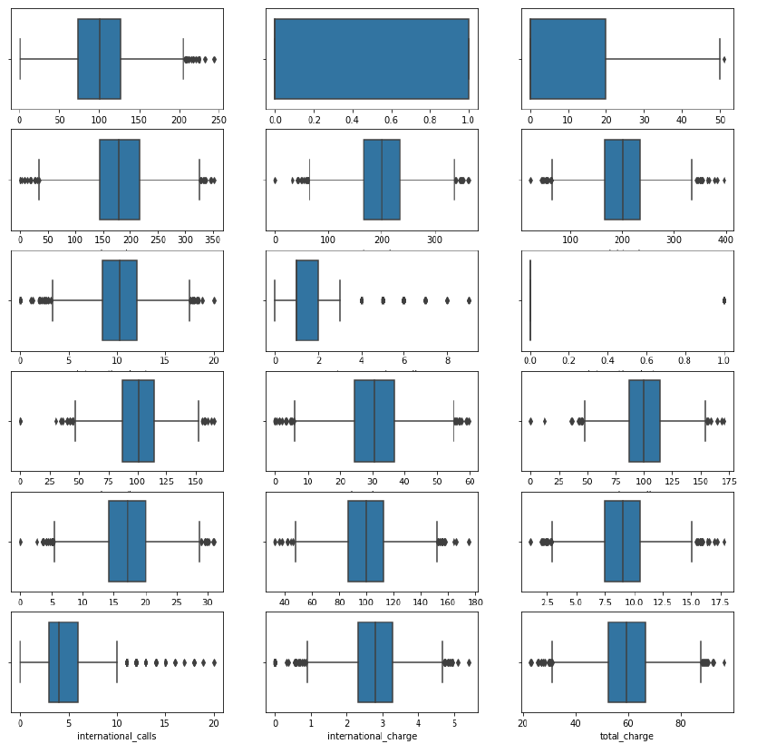
Feature Outlier Analysis
All the features more or less follow normal distribution with “international calls “ & “customer service calls” being positively skewed.
We can see that the outliers do exist but they do not look like error values. Hence, retaining the outliers for model training.

Slide 15
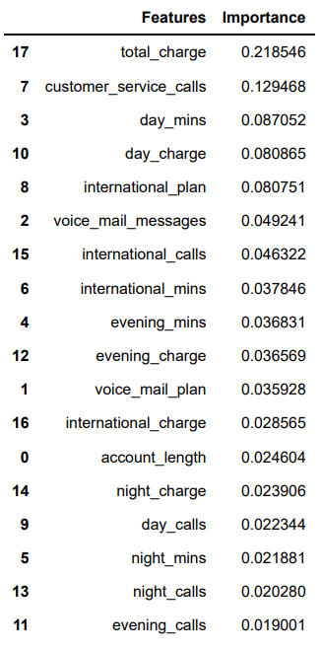
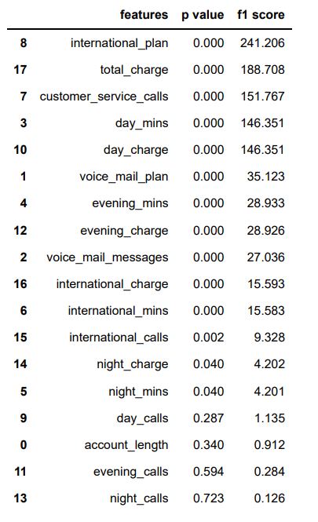
Feature Extraction
Feature extraction involved use of :
Random Forest through use of Random Forest Classifier.
ANOVA through use of SelectKBest, f_classif
Correlation Matrix by identifying five pair of features having correlation equal to 1
Random Forest
ANOVA
Thus, we can see from Random Forest and ANOVA – day calls, evening calls, night calls and account length are least important.

Slide 16
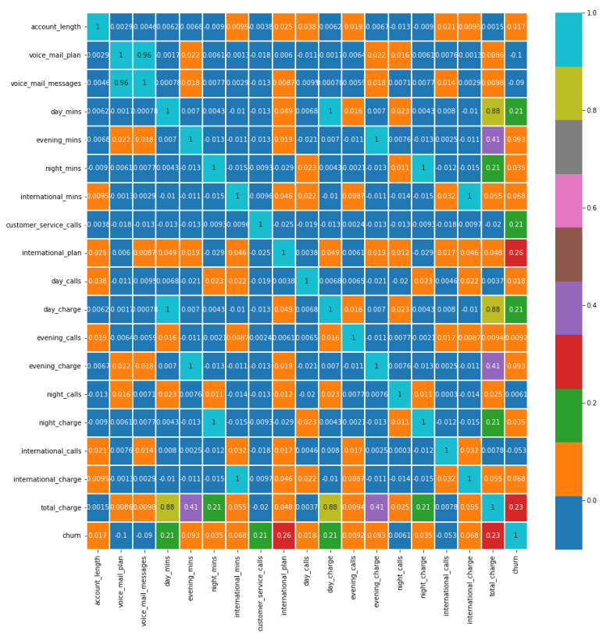
Correlation Matrix
Identified 5 predictor pairs with correlation 1 as they provide duplicate information.
Hence, dropped voice mail plan, evening charge, day charge, night charge and international charge.

Slide 17
Methodology used for model building
CASE1: Models were built by dropping 5 features identified in correlation matrix. Hence, 5 columns were dropped.
CASE2: Models were built by dropping 5 features identified in correlation matrix + by dropping least important features identified through Random Forest and ANOVA. Thus ,9 columns were dropped.
CASE 3: Models were built without dropping any features and try to utilize all the features and check for the accuracy.
CASE 4: We merged few columns to create a single column and then build the models.

Slide 18
Methodology used for Case 1
CASE1: Models were built by dropping 5 features identified in correlation matrix. Hence, 5 columns were dropped.
S.No. | Algorithm | Accuracy achieved
1. | Logistic Regression | 99.86%
2. | Decision Trees | 97.87%
3. | SVM | 91.15%
4. | Neural Network | 89.11%
Please note the above figures have been achieved by employing techniques that take into account the imbalanced dataset through oversampling, weighted networks. Also, ensemble techniques were used too for improved accuracy.

Slide 19
Methodology used for Case 2
CASE2: Models were built by dropping 5 features identified in correlation matrix + by dropping least important features identified through Random Forest and ANOVA. Thus ,9 columns were dropped.
S.No. | Algorithm | Accuracy achieved
1. | Logistic Regression | 99.84%
2. | Decision Trees | 97.84%
3. | SVM | 93.70%
4. | Neural Network | 88.27%
Please note the above figures have been achieved by employing techniques that take into account the imbalanced dataset through oversampling, weighted networks. Also, ensemble techniques were used too for improved accuracy.

Slide 20
Methodology Used in Case 3
Case 3 : Not dropping any features and trying to achieve maximum accuracy
S.No. | Algorithm | Accuracy achieved
1. | Logistic Regression | 84%
2. | Gussian NB | 84%
3. | Decision Tree | 98%
4. | Random Forest | 98%
5. | XGBoost | 98%

Slide 21
Methodology Used in Case 4
Case 4 : We merged few columns to create a single column. We dropped models built in case 4 based on low accuracy.

Slide 22
Final model selection
Taking into account accuracy and parsimonious model, Logistic Regression from case 2 was selected for deployment.
In the selected model 9 features were dropped and accuracy achieved was 99.84%.

Slide 23
Deployment
Deployment was done on Streamlit.
Code has been submitted too.

Slide 24
Thank You

